Slide 1
Big data graduation project
Presented By: Mahmoud Mohamed Soheil
Presented to: eng. Amr salah
eng. Ahmed reda

Slide 2
Agenda
Data Ingestion
Data Storage
Data Processing and Analysis
Data Visualization
Oozie workflow
Part of Output file

Slide 3
Data ingestion
First phase is to transfer the dataset file from local machine to cloudera virtial machine using normal copy and paste (Ctrl+C, Ctrl+V)
Second phase is to put the data on the system which is hdfs through the two commands. One to create the directory where we will put the dataset (CSV file) and the other is to put the data set in hdfs.
Data Storage

Slide 4
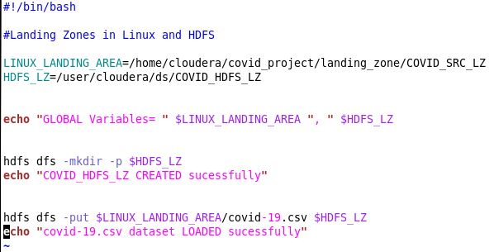
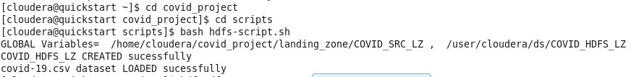
Data Storage

Slide 5
Data processing and analysis
Third phase is to move the data to hive by creating the database and loading the data from csv to the first table and then partitioning data into another table which uses mapreduce to load the data faster

Slide 6
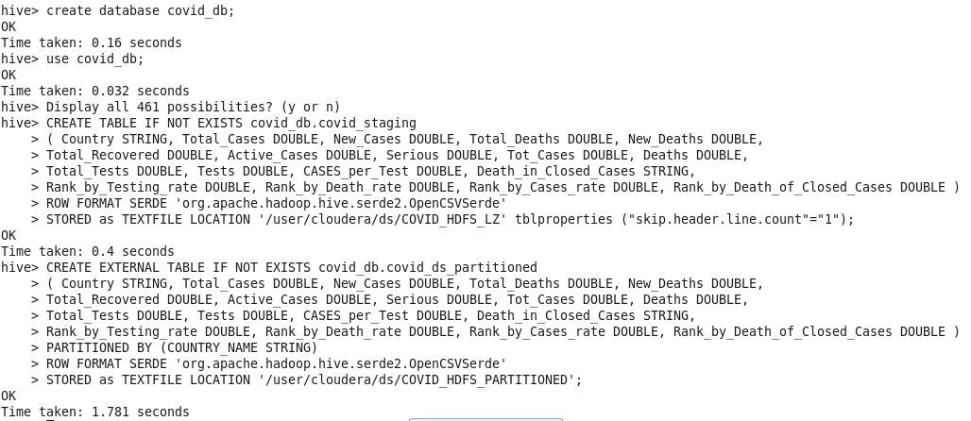
Data processing and analysis

Slide 7
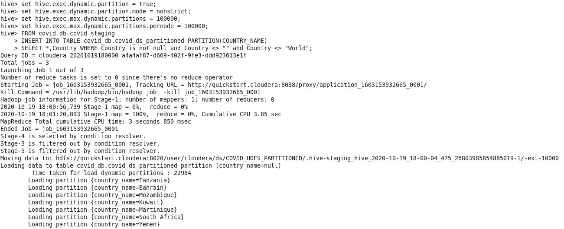
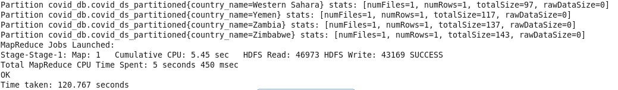
Data processing and analysis

Slide 8
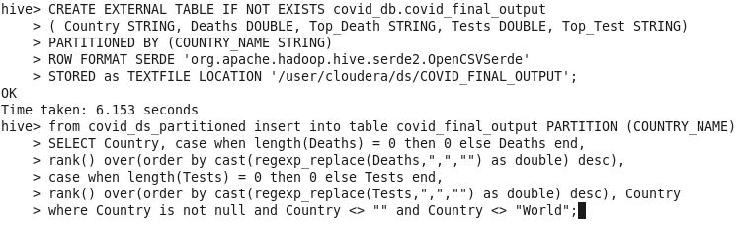
Data processing and analysis
Then I created a third table in which I calculated the rank of each country according to death rate and tests rate by using rate function but there was a problem with the serde format as it converts all fields to string so I needed to cast them to double but there was a problem with the comma in the numbers so I removed it by replacing it with empty string and also I replaced any null values with 0

Slide 9
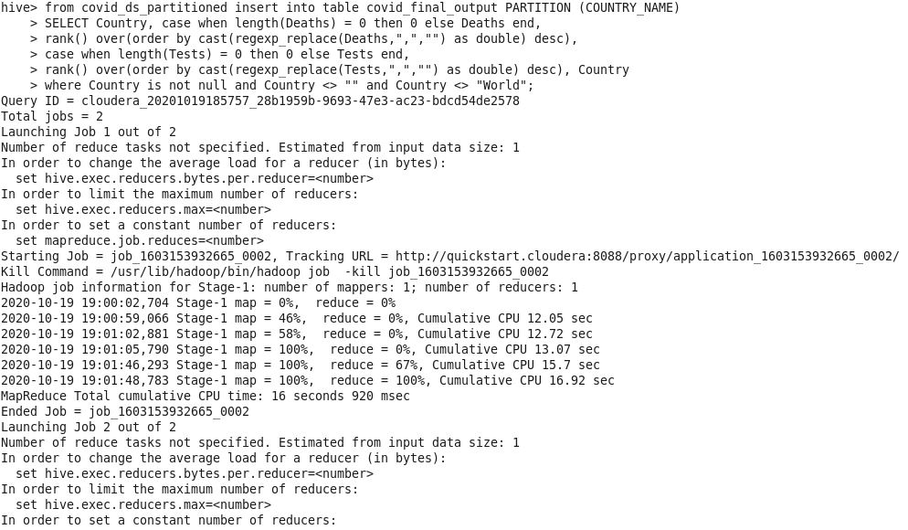
Data processing and analysis

Slide 10
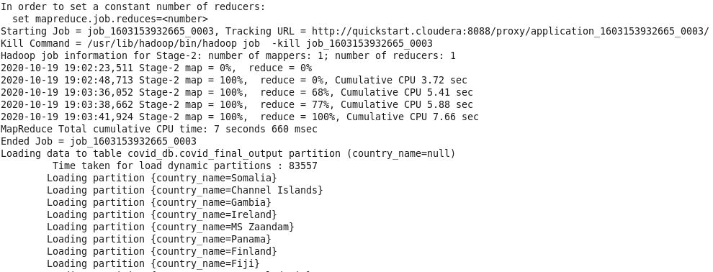
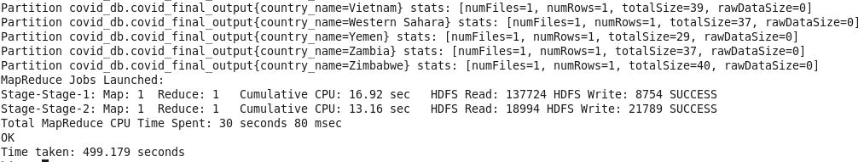
Data processing and analysis

Slide 11
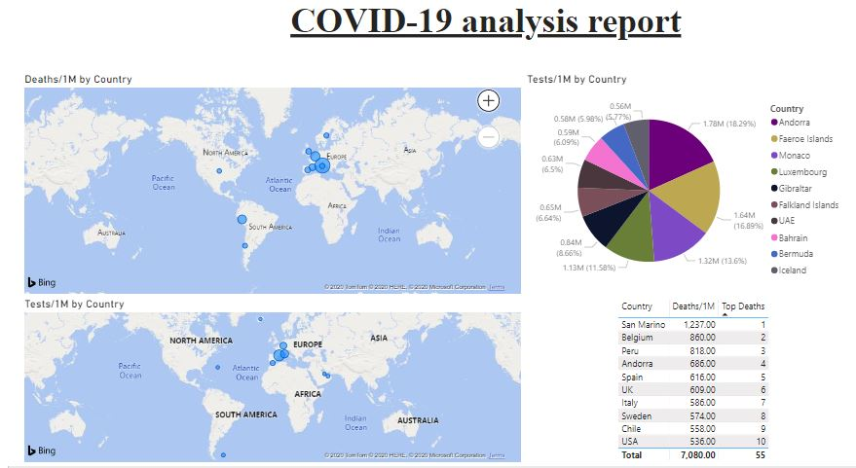
Data Visualization
Fourth phase is to export the third table which contains the analysis into a csv file and then visualize the data using powerBI by importing data on it and showing top 10 in death rate and in tests rate on the map

Slide 12
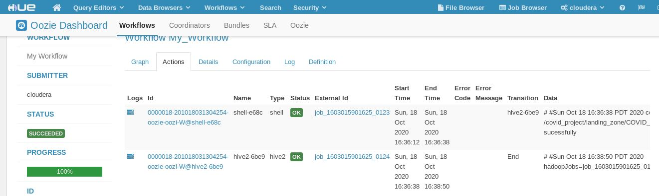
Oozie workflow
Last thing I made is to use oozie to automatically run the hdfs and hive scripts as a workflow or pipeline and that was the result

Slide 13
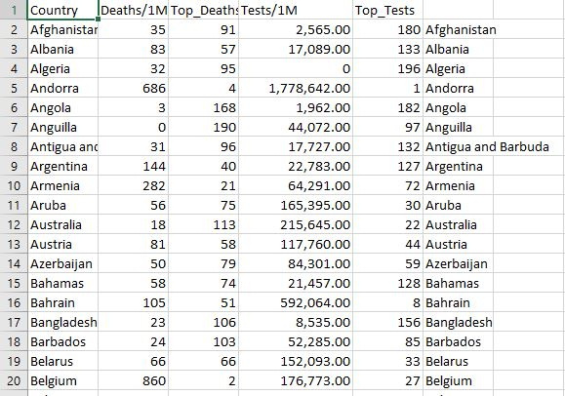
Part of Output file
This is a part of the output file that I exported from hive into csv file that contains analysis done in third table

Slide 14
Thank you

